Slide 1
Understanding Data Representation
By Hamza sherif
How Data is Stored and Processed in the Digital World
22
5
2025

Slide 2
Agenda
01
Introduction
Slide 00
02
Binary: The Language of Computers
Slide 01
03
Hexadecimal: A Convenient Shortcut for Binary
Slide 02
04
Text Representation: ASCII and Unicode
Slide 03
05
Sources and References
Slide 04
06
Thank you
Slide 05
Confidential

Slide 3
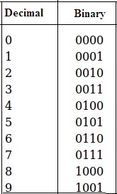
Binary is the fundamental language of computers.
It uses only two digits: 0 and 1, also known as bits.
Byte = 8 bits, which represents a single character or piece of data.
All data in a computer, from text to images, is ultimately represented in binary.
Binary: The Language of Computers
Confidential

Slide 4
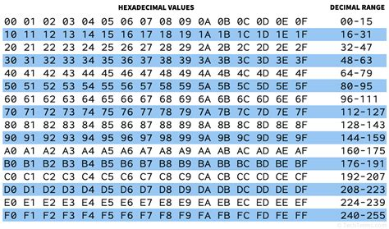
Hexadecimal: A Convenient Shortcut for Binary
Hexadecimal (Hex) is a base-16 number system, using digits 0-9 and letters A-F.
It is often used to represent large binary numbers more concisely.
1 Hex digit = 4 binary digits (bits), making it easier to read and write binary data
Confidential

Slide 5
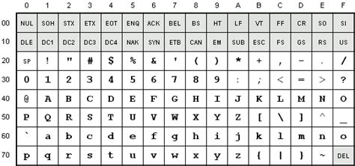
Text Representation: ASCII and Unicode
ASCII (American Standard Code for Information Interchange):
Uses 7 bits to represent 128 characters: English letters, numbers, punctuation marks, and control characters.
Example: The letter "A" in ASCII is 01000001.
Unicode:
An extended system that includes over 137,000 characters from multiple languages, symbols, and even emojis (uses up to 32 bits per character).
Unicode is a universal standard that ensures text is represented consistently across systems.

Slide 6
Sources & references
"Understanding Binary Code," by John Doe, TechBooks Publishing, 2022.
"A Guide to Hexadecimal," www.examplewebsite.com.
"ASCII and Unicode Standards," www.unicode.org.
"Color Representation and Hexadecimal," www.colorpedia.com.

Slide 7
Thank you!
Contact our team
12.hamza.sherif@gmail.com
Confidential

